Slide 1

NAME :- ANUBHAV KUMAR SINGH

Slide 2
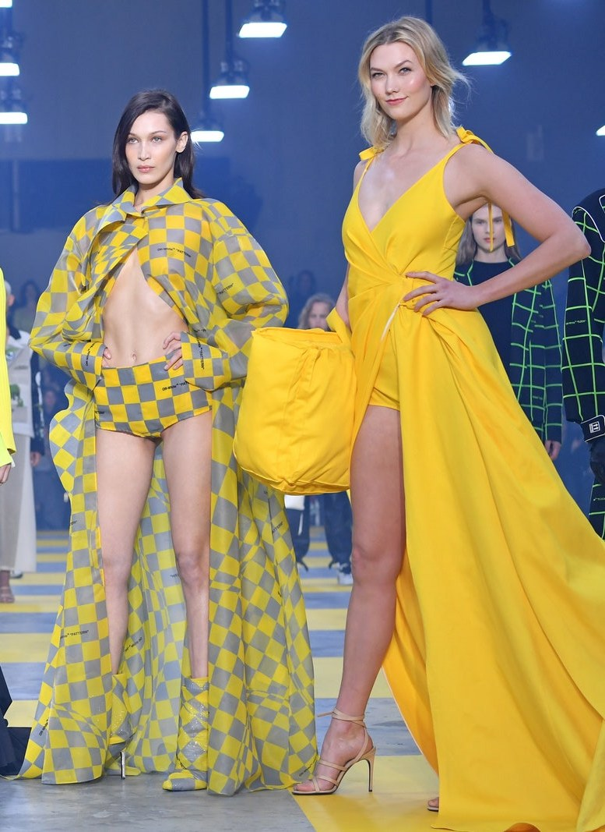
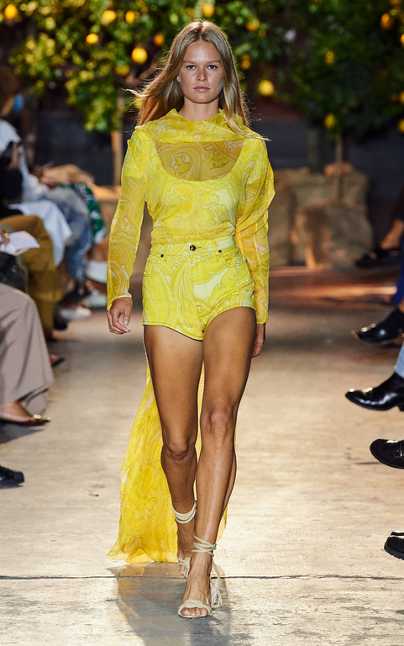
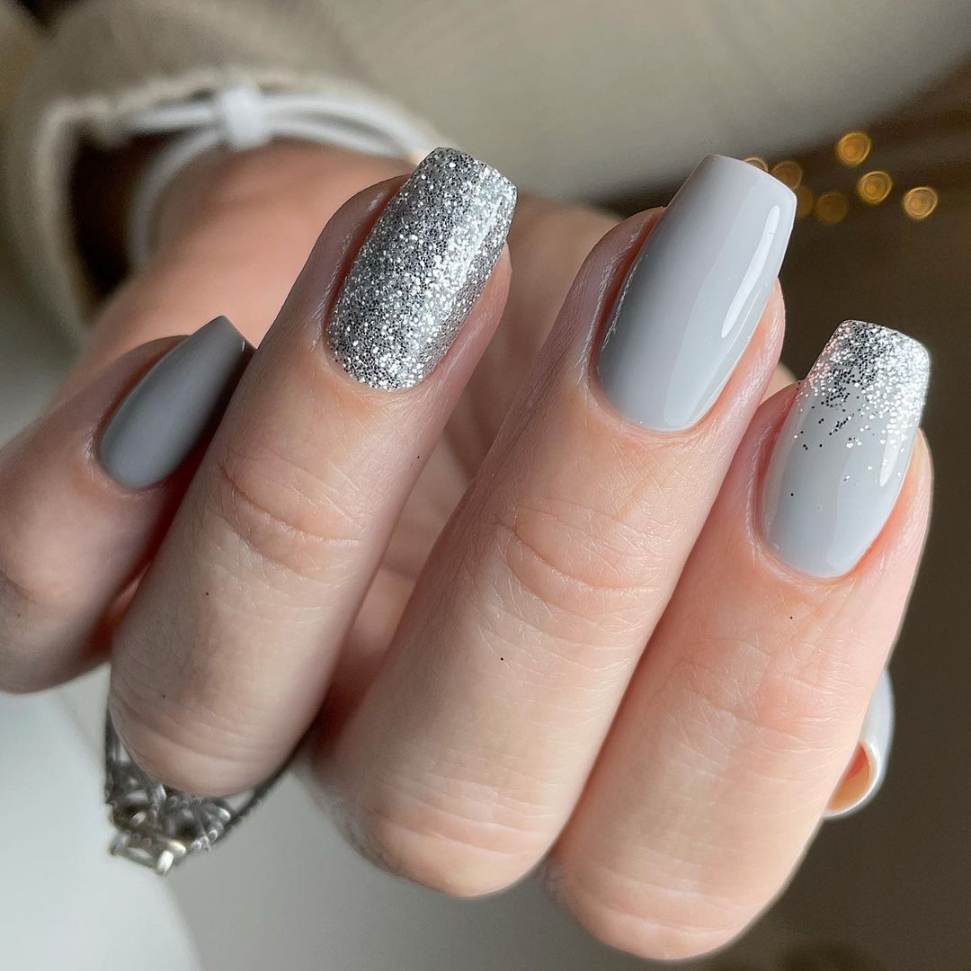

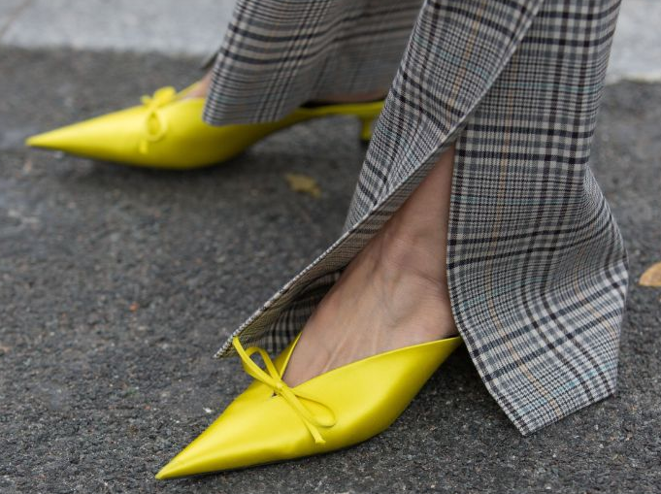

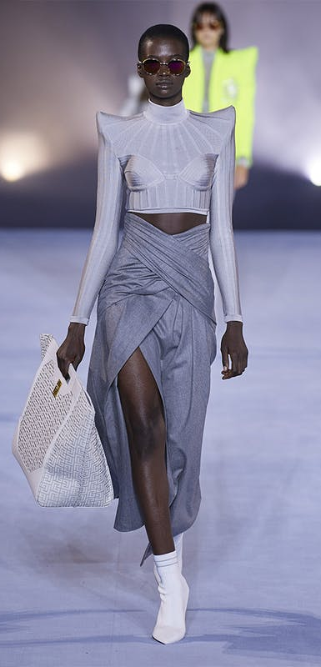


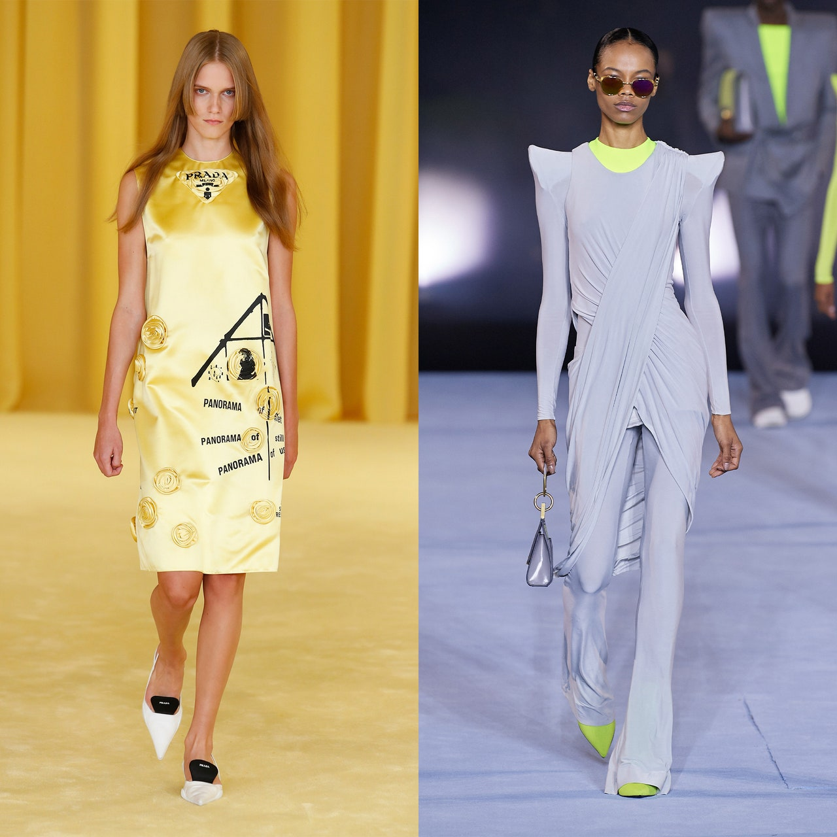
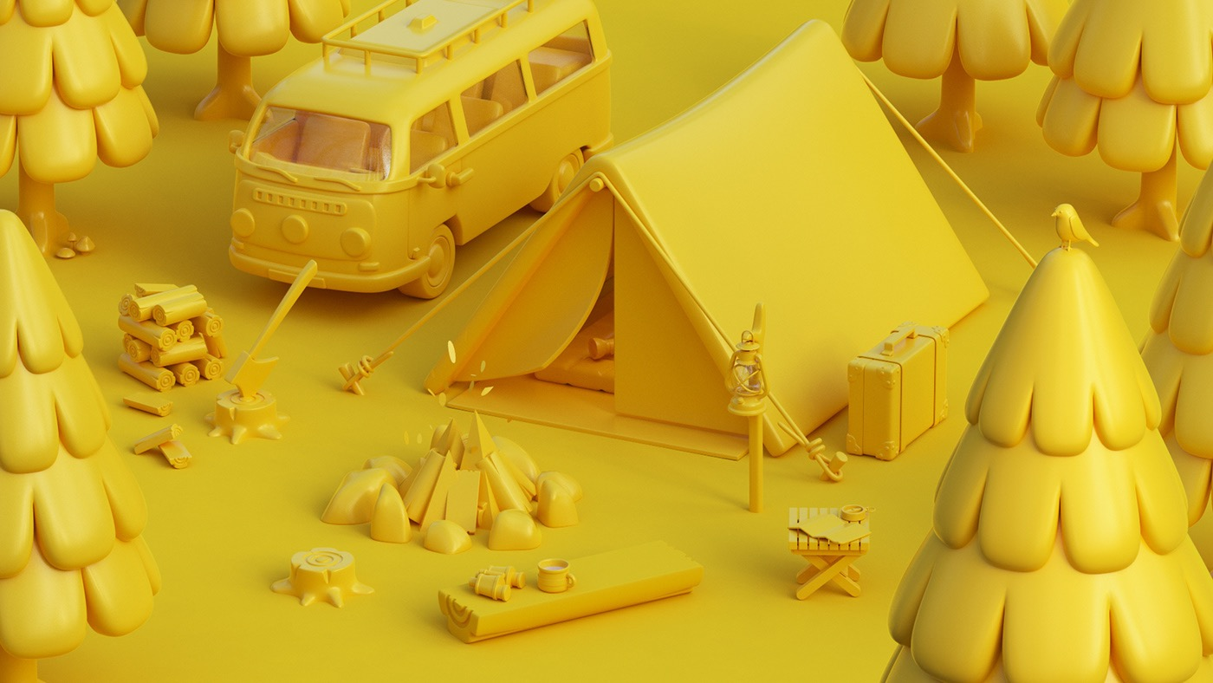

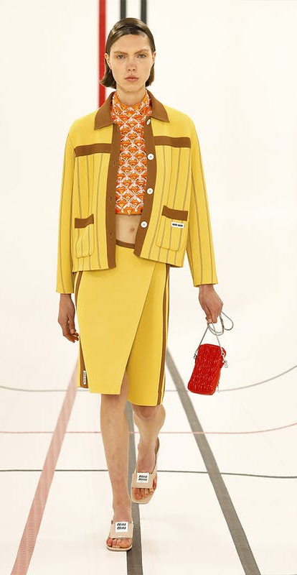
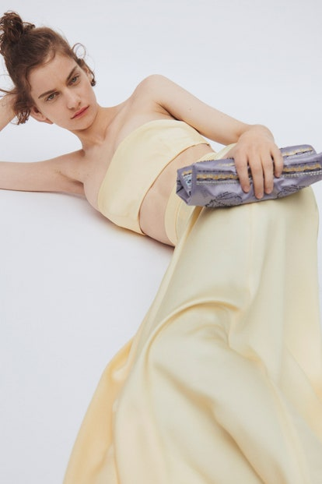
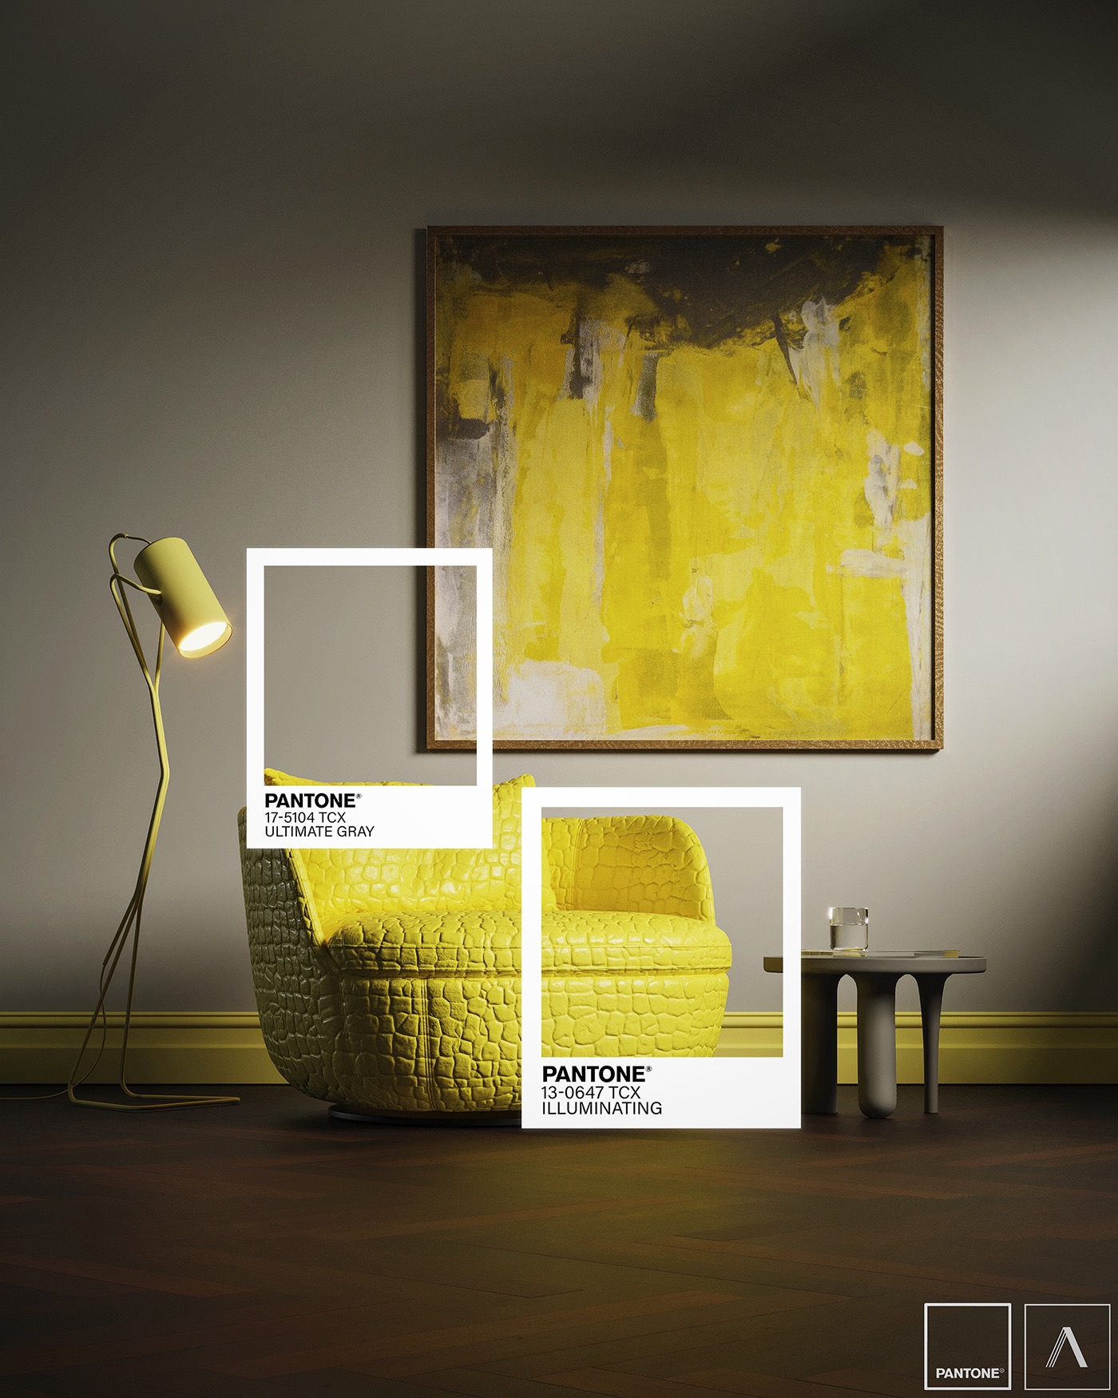


ASH
Balmain
ERTO
NOON
WOOL
CHECKERS
ELEGANT
BRIGHT
Jacquemus
MIU MIU
PARADA
SPRING/SUMMER :-21
BOLD
Emilio Pucci

Slide 3


NOON= NOON TIME WHEN SUN IS OVER HEAD AND BRIGHT
AND SHADOWS ARE GREY

